Slide 1
Digital Marketing Dataset Analysis
By: Anshukman M J

Slide 2
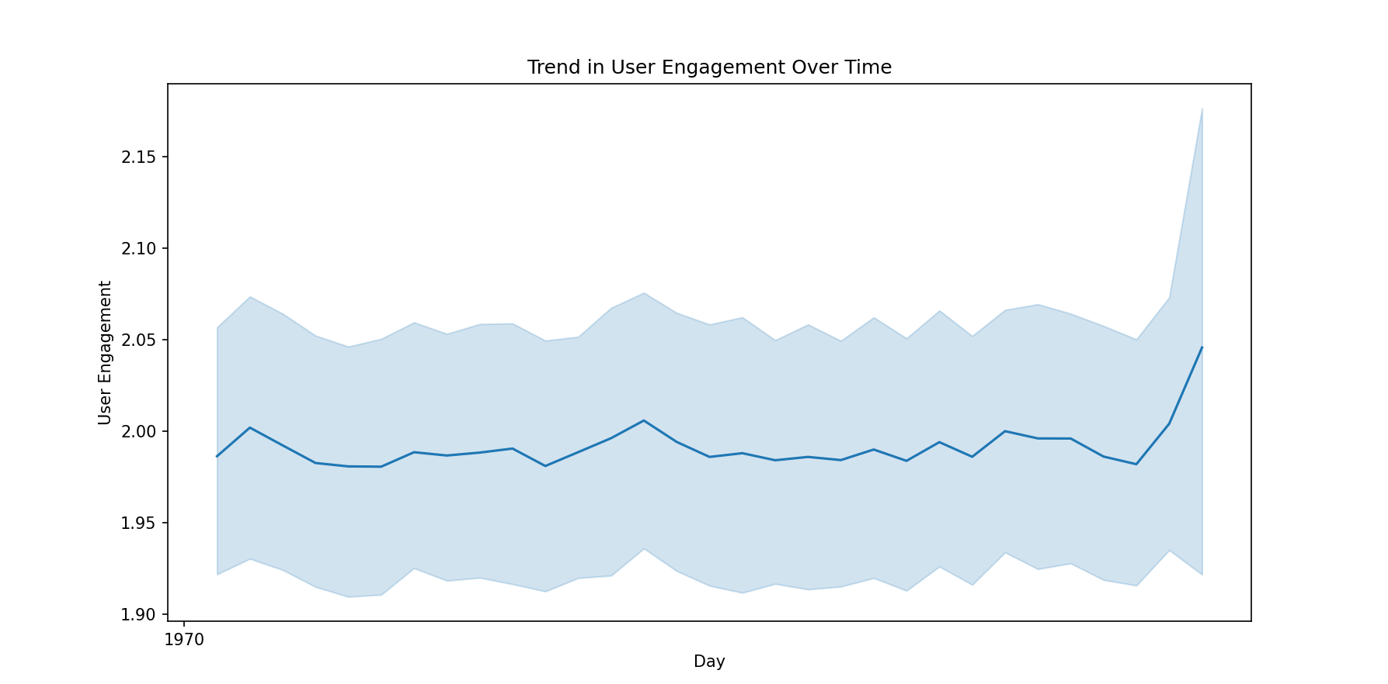
· What is the overall trend in user engagement throughout the campaign period?

Slide 3
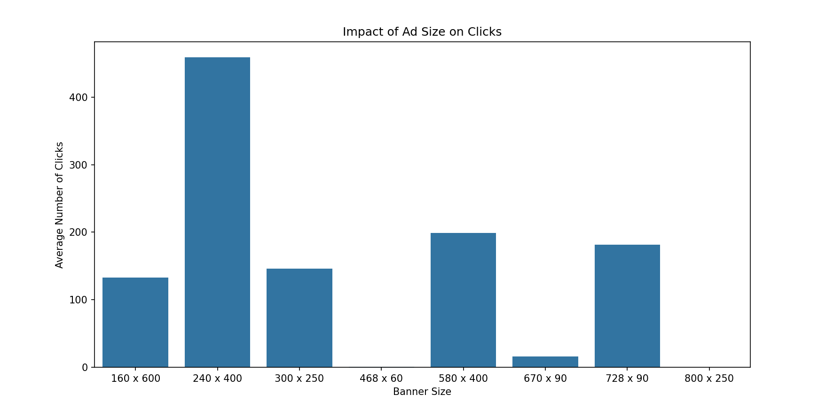
· How does the size of the ad (banner) impact the number of clicks generated?

Slide 4
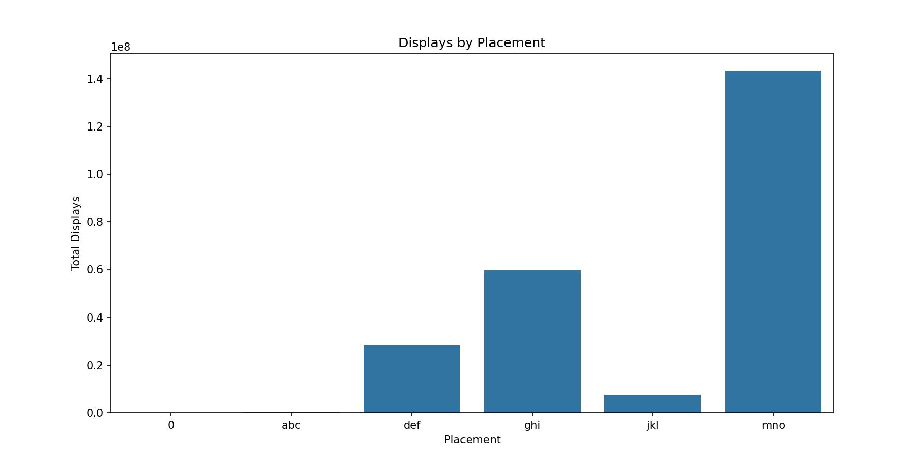
Which publisher spaces (placements) yielded the highest number of displays and clicks?
Publisher with highest number of displays: mno

Slide 5
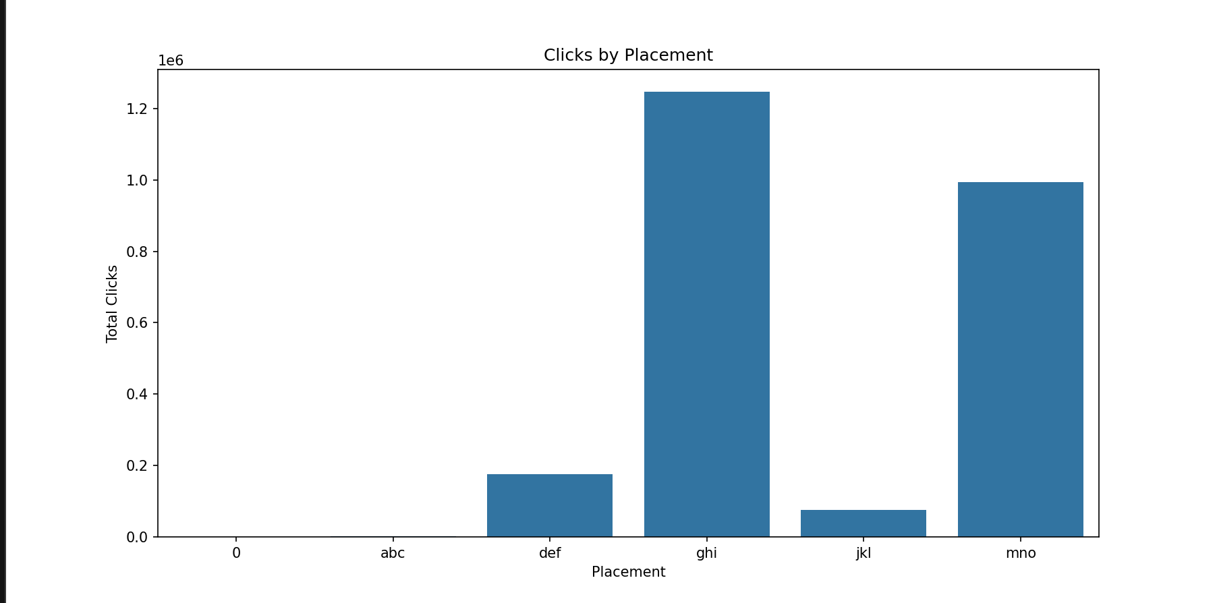
Which publisher spaces (placements) yielded the highest number of displays and clicks?
Publisher with highest number of clicks: ghi

Slide 6
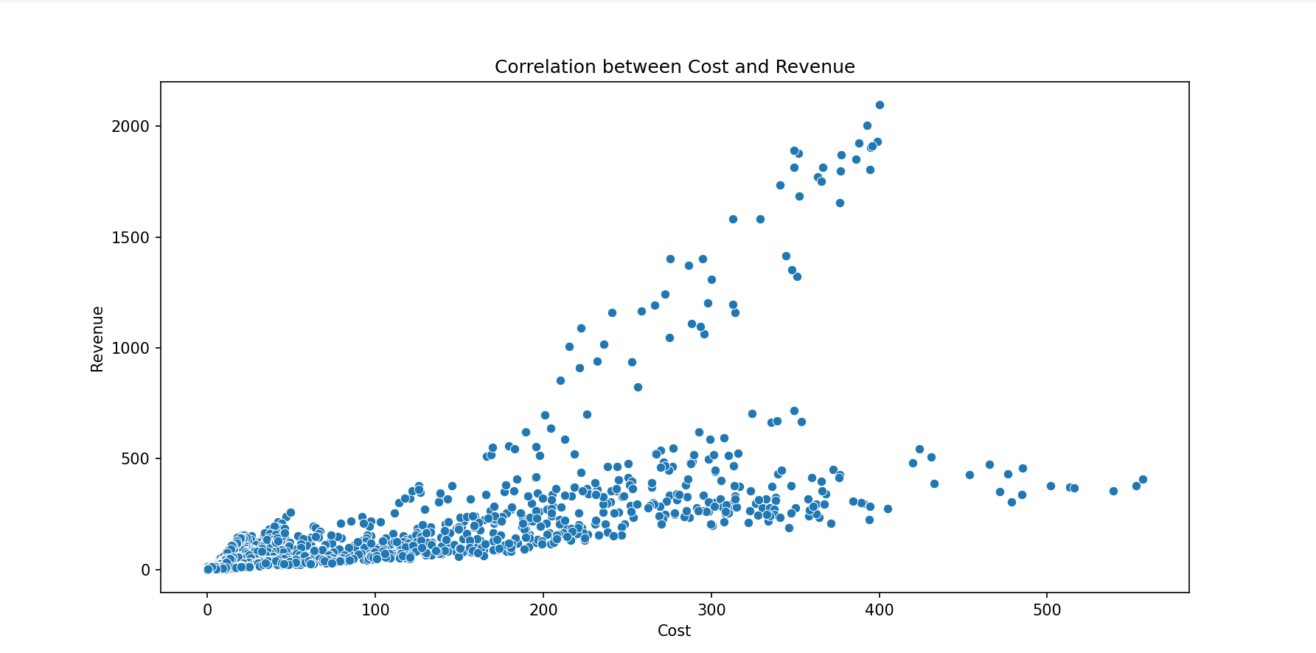
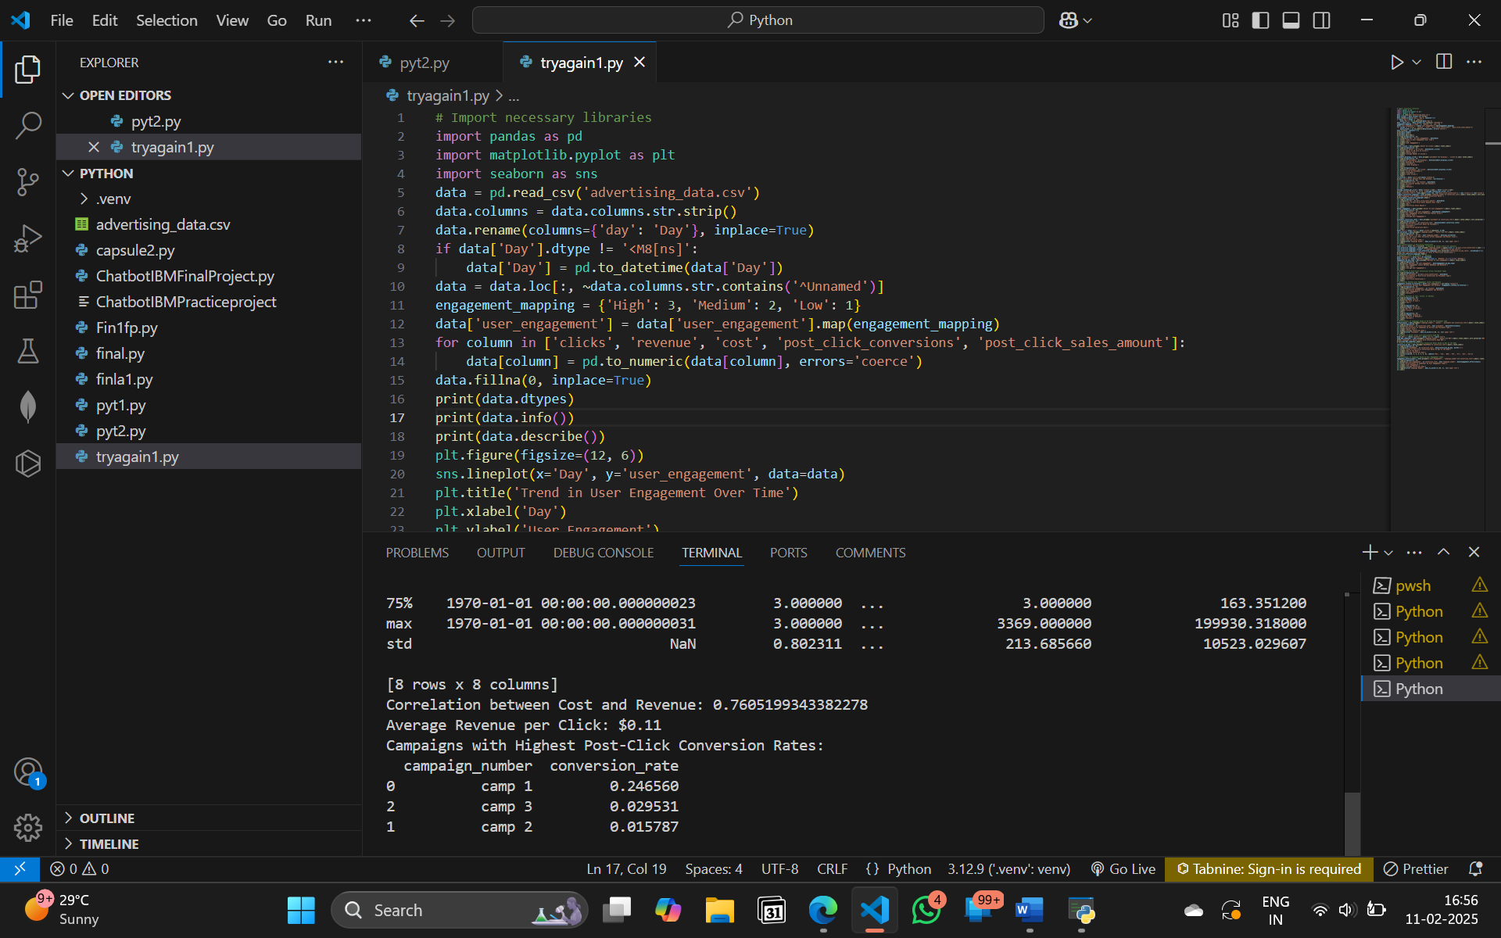
· Is there a correlation between the cost of serving ads and the revenue generated from clicks?

Slide 7
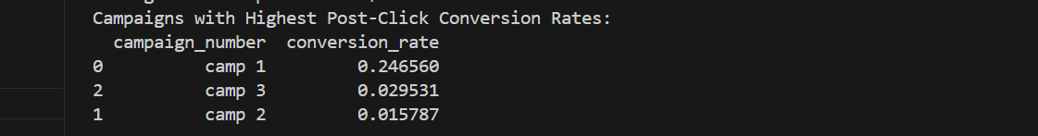
· · · What is the average revenue generated per click for Company X during the campaign period?
· Which campaigns had the highest post-click conversion rates?

Slide 8
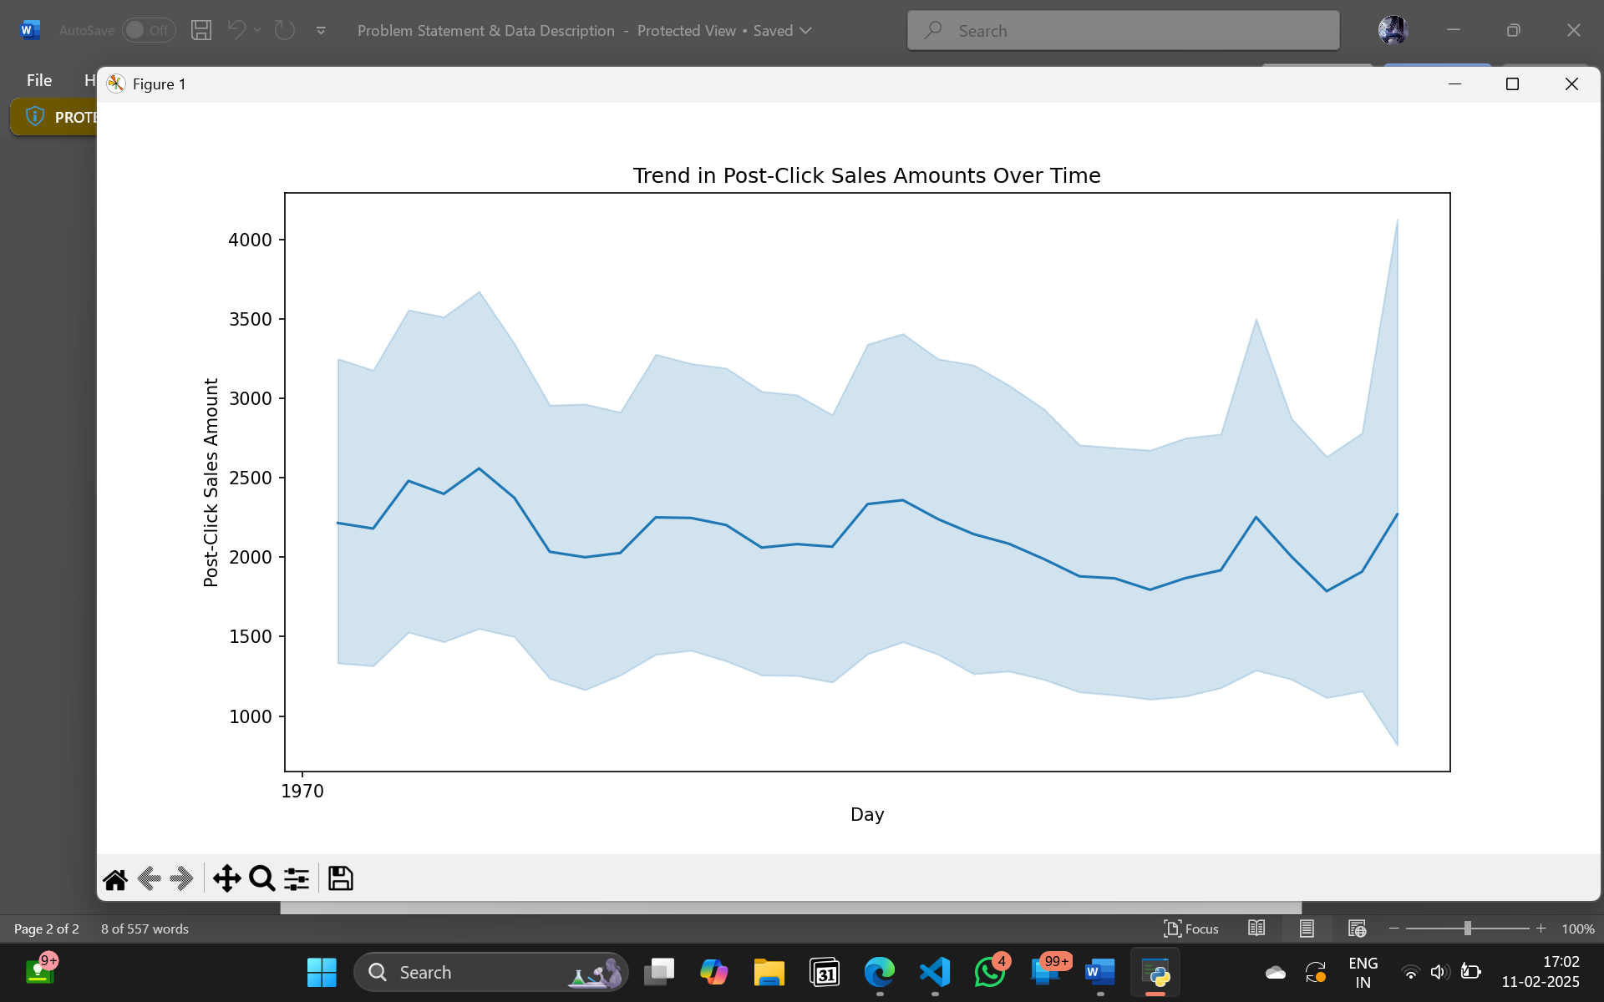
· · Are there any specific trends or patterns in post-click sales amounts over time?

Slide 9
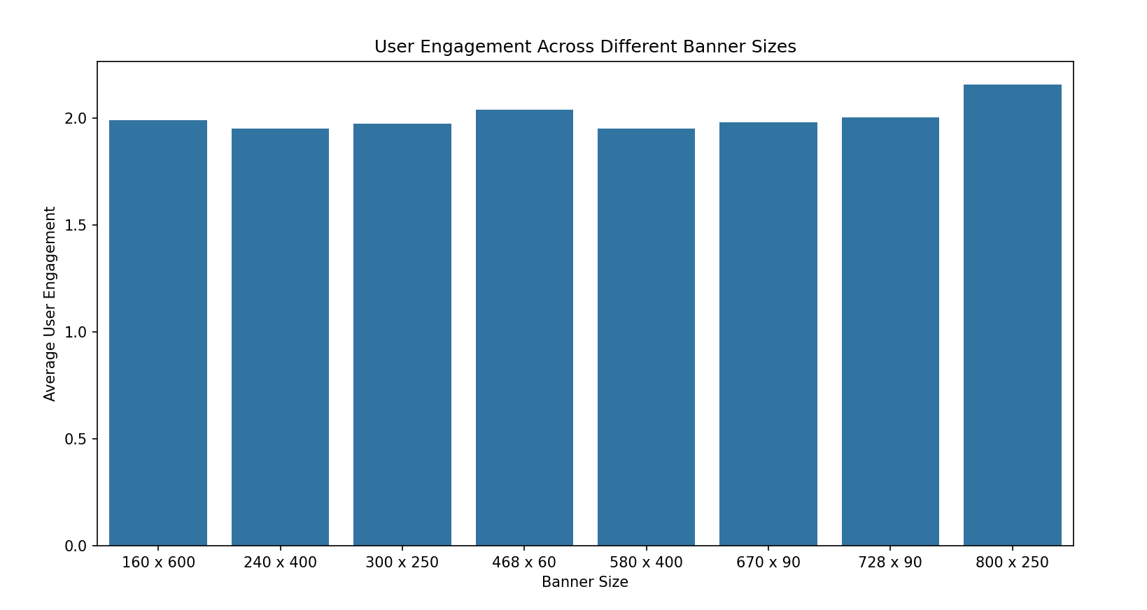
How does the level of user engagement vary across different banner sizes?

Slide 10
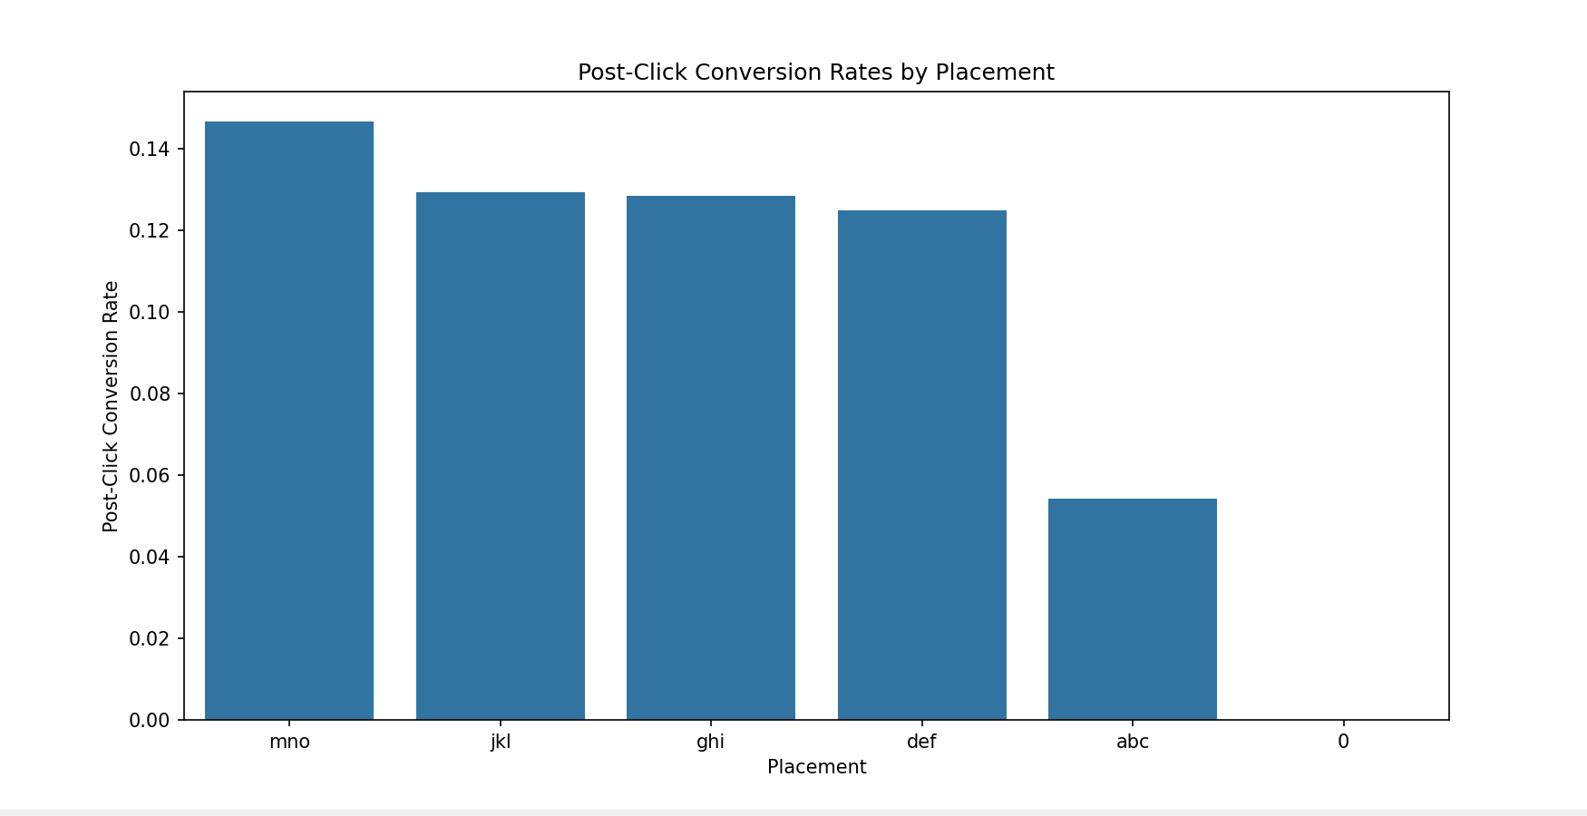
Which placement types result in the highest post-click conversion rates?
Mno results in highest post click conversion rates.

Slide 11
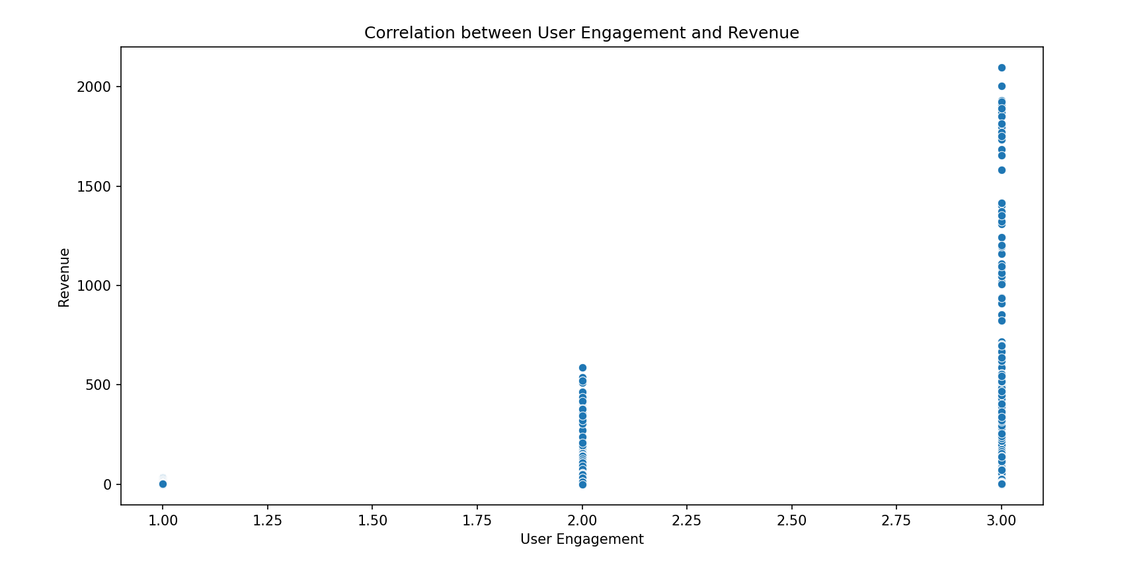
Is there a correlation between user engagement levels and the revenue generated?

Slide 12
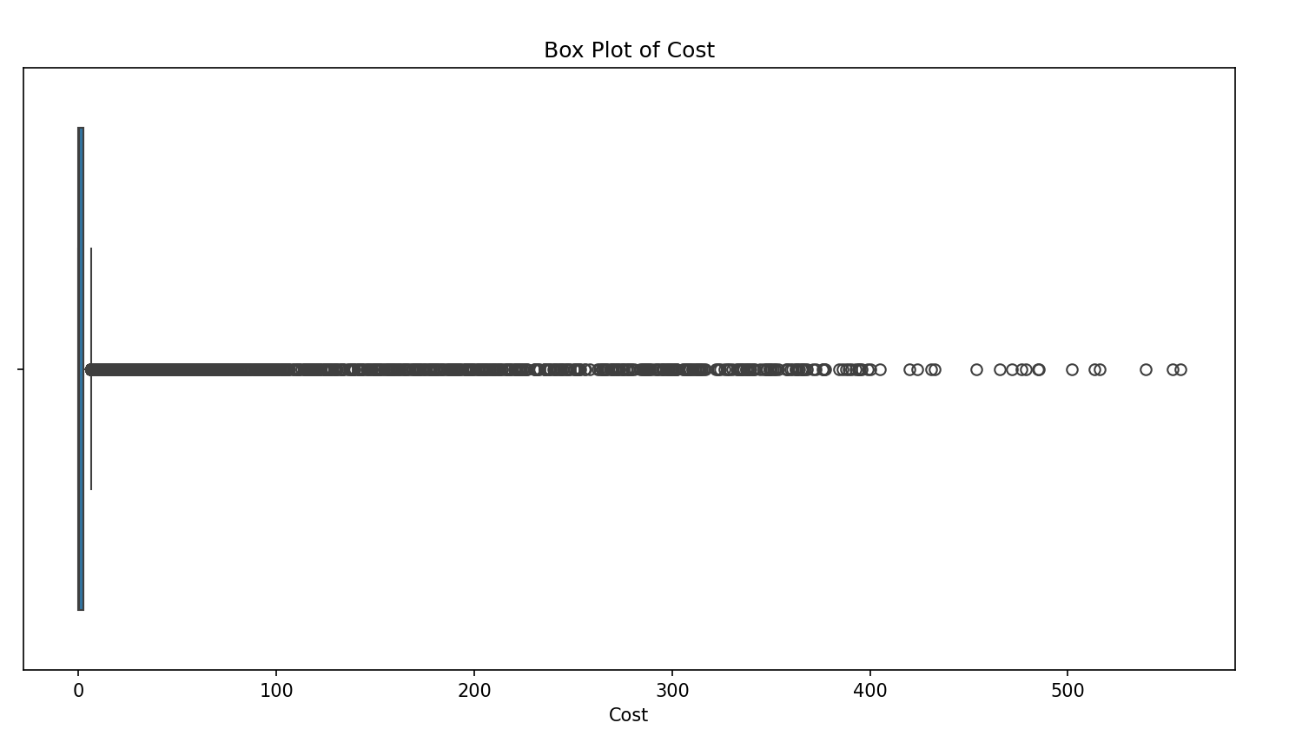
Are there any outliers in terms of cost, clicks, or revenue that warrant further investigation?

Slide 13
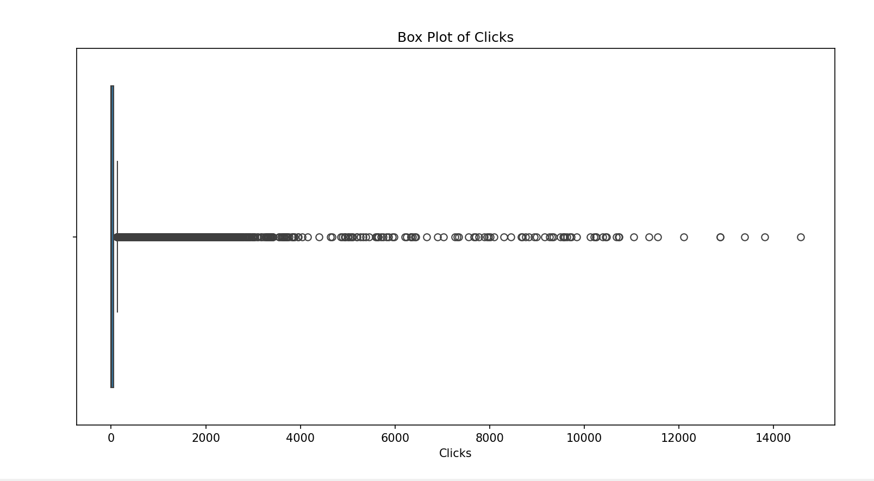
Are there any outliers in terms of cost, clicks, or revenue that warrant further investigation?

Slide 14
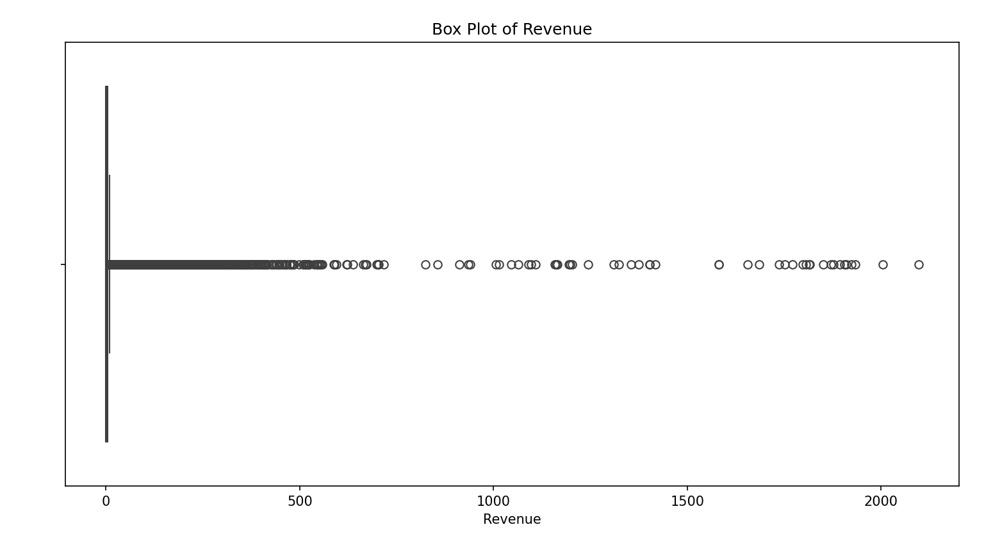
Are there any outliers in terms of cost, clicks, or revenue that warrant further investigation?

Slide 15
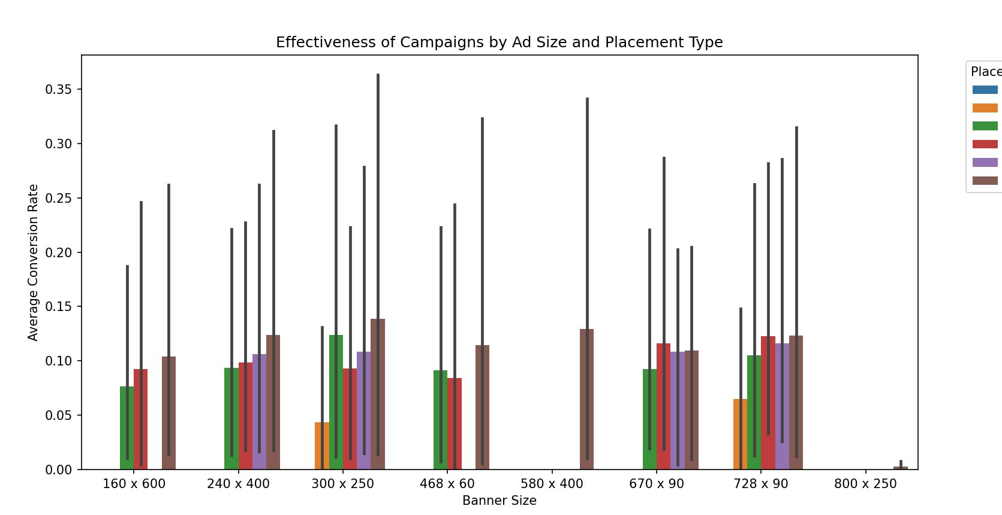
· · How does the effectiveness of campaigns vary based on the size of the ad and placement type?

Slide 16
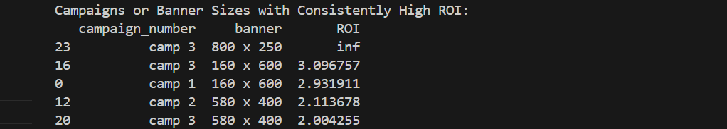
Are there any specific campaigns or banner sizes that consistently outperform others in terms of ROI?

Slide 17
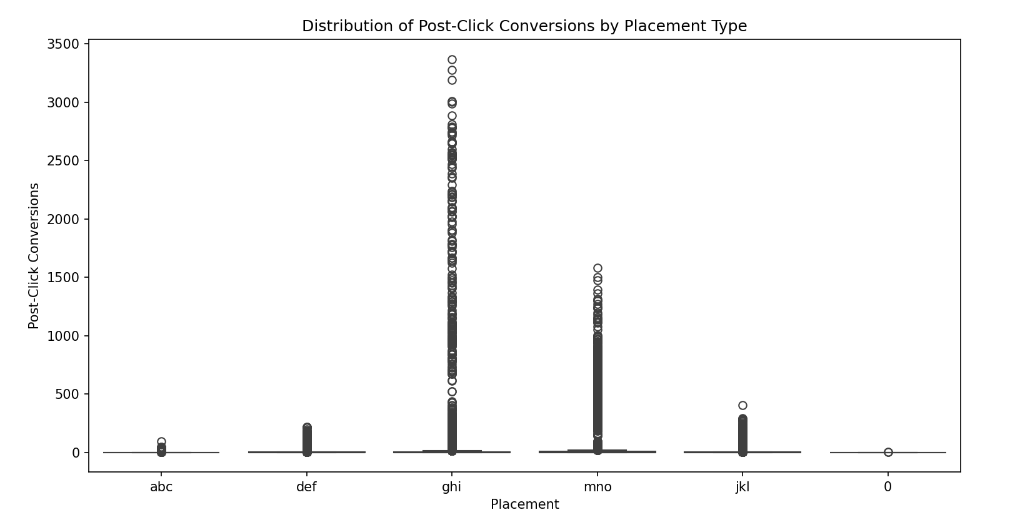
What is the distribution of post-click conversions across different placement types?

Slide 18
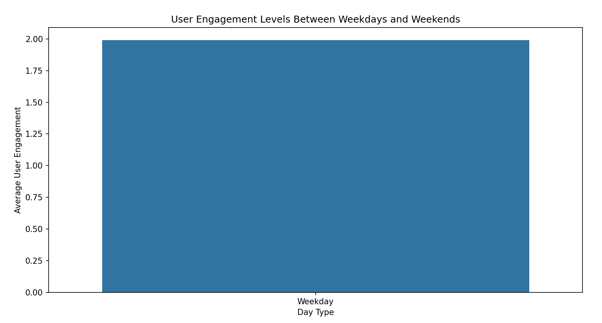
Are there any noticeable differences in user engagement levels between weekdays and weekends?

Slide 19
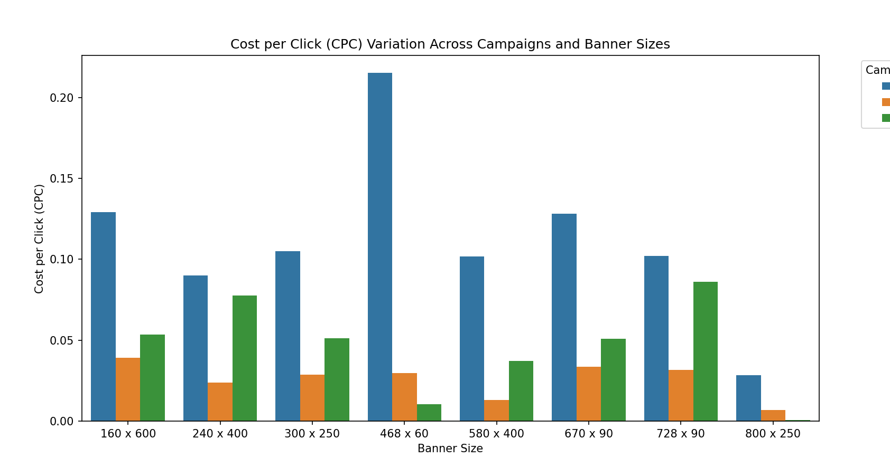
How does the cost per click (CPC) vary across different campaigns and banner sizes?

Slide 20

Are there any campaigns or placements that are particularly cost-effective in terms of generating post-click conversions?

Slide 21
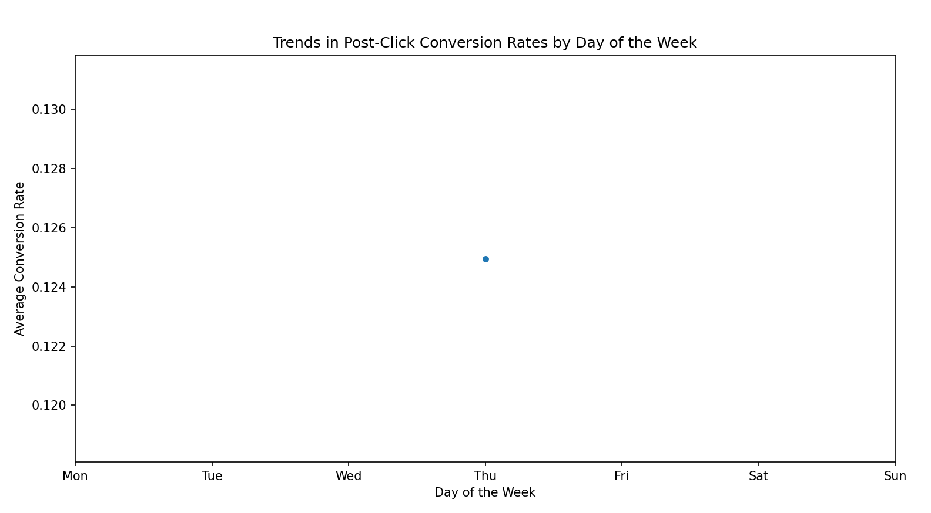
Can we identify any trends or patterns in post-click conversion rates based on the day of the week?

Slide 22
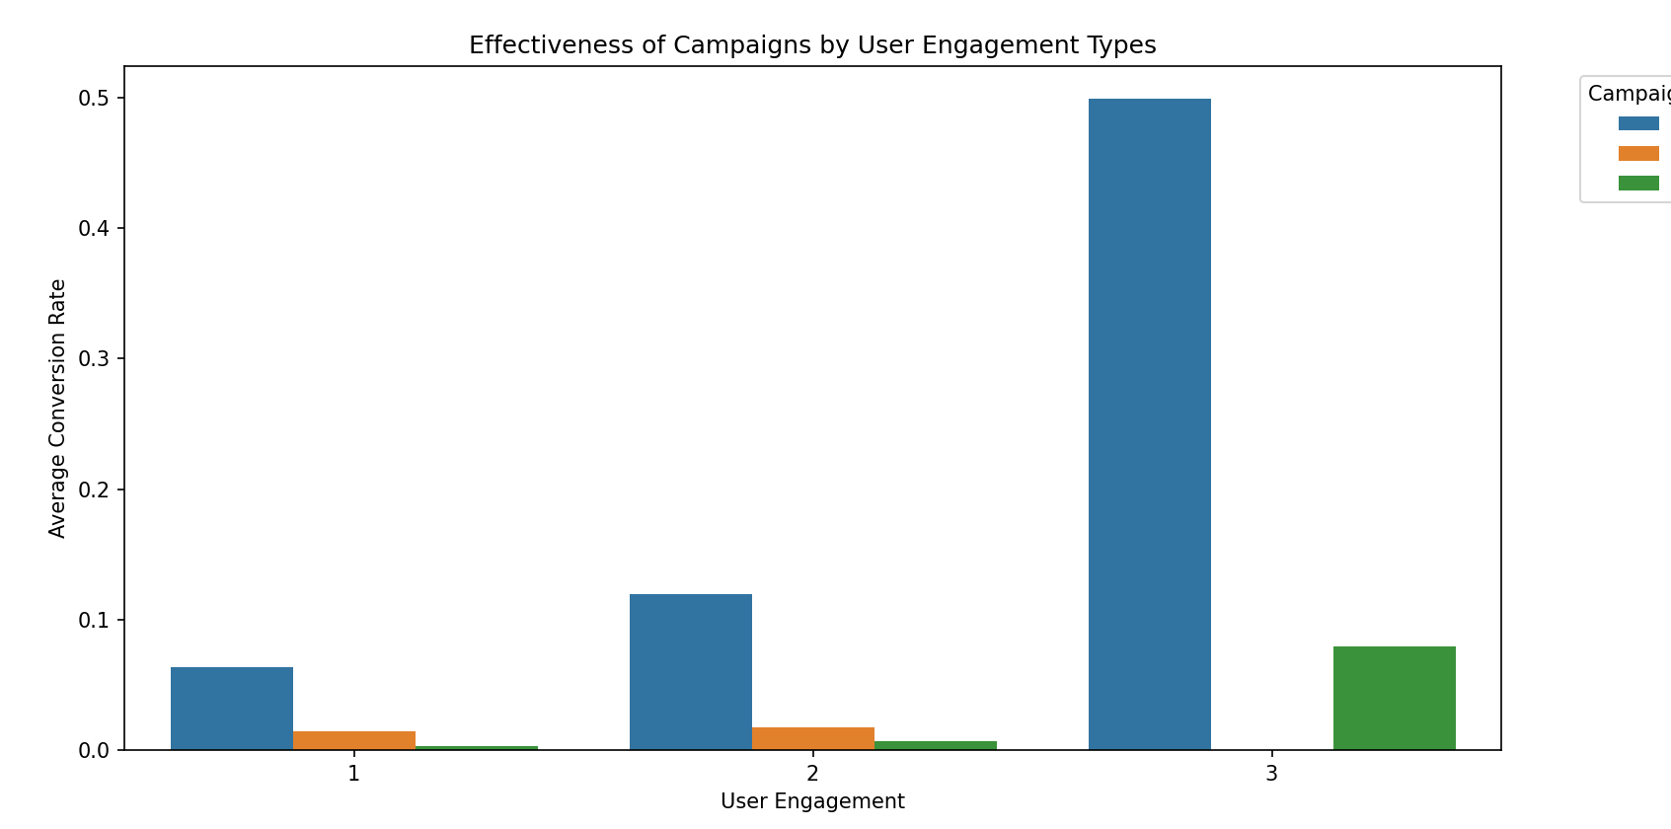
· · How does the effectiveness of campaigns vary throughout different user engagement types in terms of post-click conversions?

